Slide 1




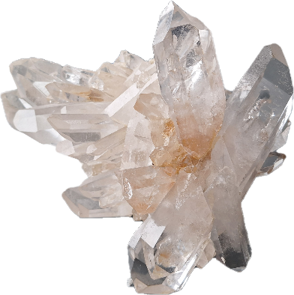
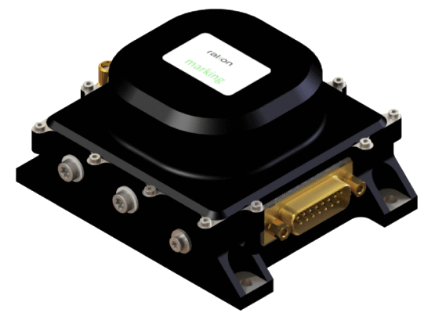



5th SPACE PASSIVE COMPONENT DAYS - SPCD 2024
15-18 October 2024 | ESA/ESTEC
Noordwijk, The Netherland
Introduction to
MINCOR - Minimisation of crystal oscillator cosmic radiation effects
ESA contract No. 4000133592/20/NL/FE
Nicolas GUFFLET, Laurent COUTELEAU, Frederic VITTRANT / RAKON
Yannick PADIE, Alexandre ROUSSET / TRAD

Slide 2
Table of content
Quartz resonators and oscillators
Radiations in space & mission profiles
Literature review & radiation sensitivity
Design of Experiment
Progress and results achieved up to now
Conclusion and perspective

Slide 3
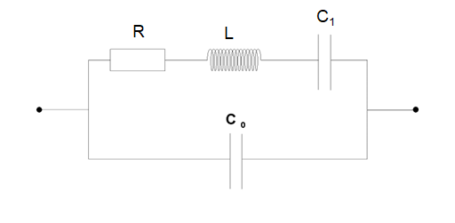
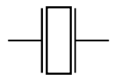
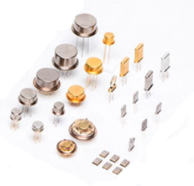
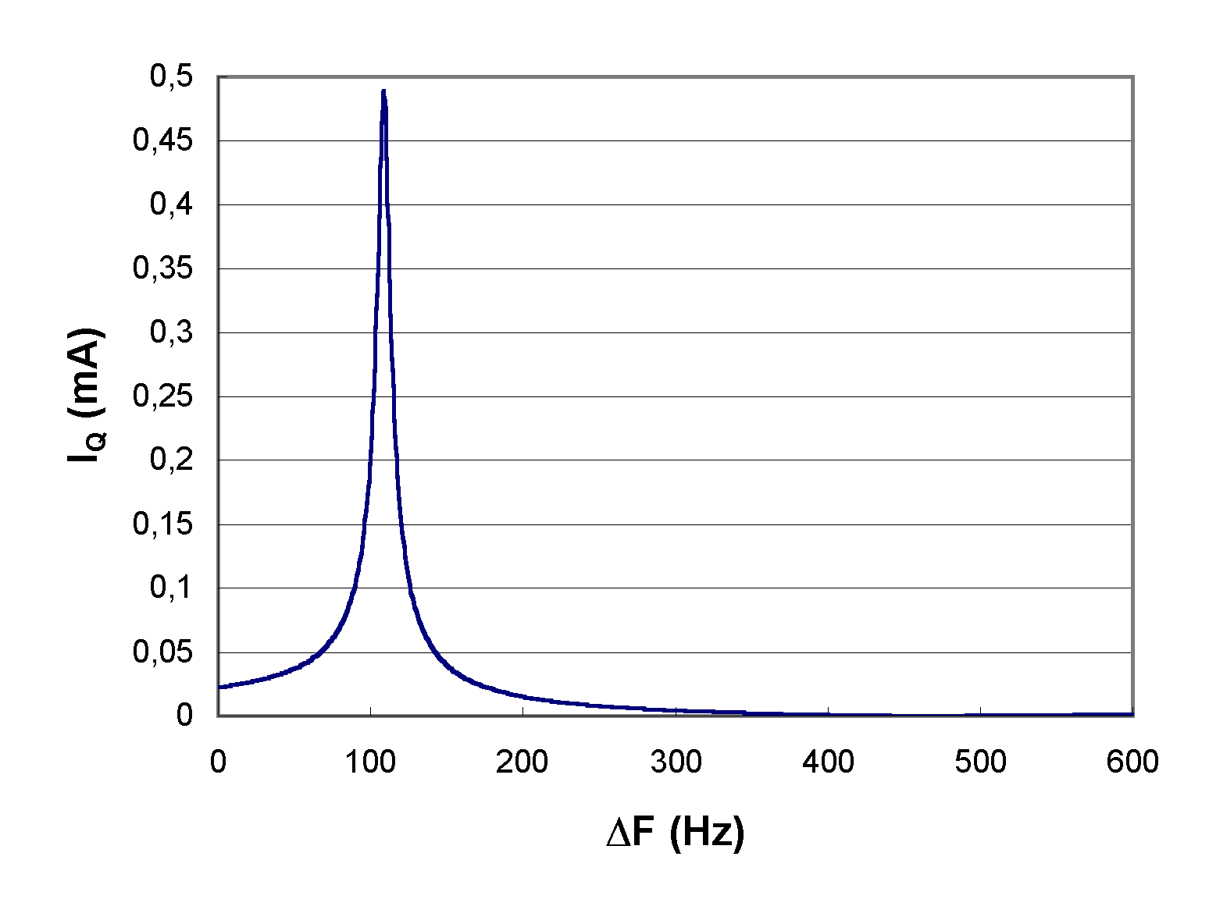
Quartz resonators
Quartz resonators are passive electronic components made of quartz crystal that present electrical resonances from few MHz to some hundreds MHz
They present inherent high stability and Q-factor
Symbol
Electrical equivalent circuitry
Quartz resonators of different sizes
Electrical resonance peak around one resonance

Slide 4
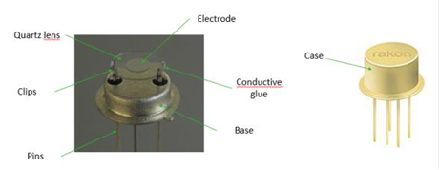
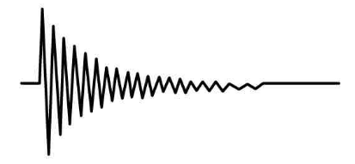
Quartz resonators
They work using the piezoelectric property of quartz material that permits electro-mechanical coupling.
Electrical resonances corresponds in fact to mechanical resonances
They do not resonate indefinitely. After an initial excitation the signal will decay (the higher the Q factor the longer time to decay)
Quartz resonator
Amplitude of the vibration after an initial excitation

Slide 5
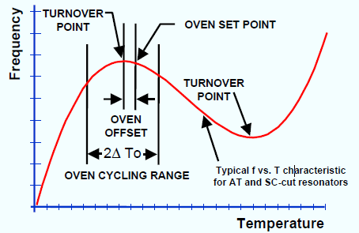
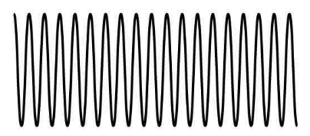
Quartz oscillators
Quartz Oscillators are active devices that sustain the quartz resonance by locking the resonator frequency
They produce a precise and stable frequency signal
They are used in many systems where there is a need of time and frequency control (radar, GPS, communication,…)
For higher stability oscillator (OCXO), the quartz resonator is heated at its turnoverpoint
Quartz oscillator and its output signal
Frequency Temperature curve of a typical resonator
(source: John Vig Tutorial)

Slide 6
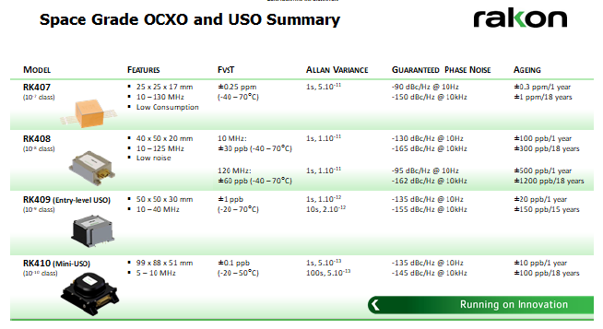
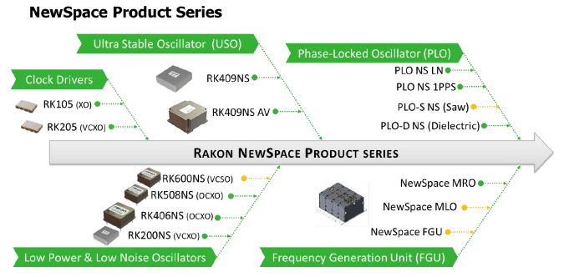
Oscillator for Space
Rakon produces different oscillator types from which the ones dedicated for space market

Slide 7
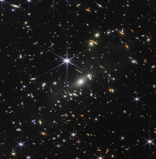
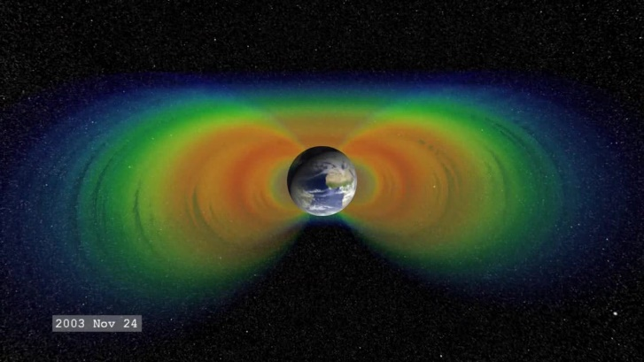
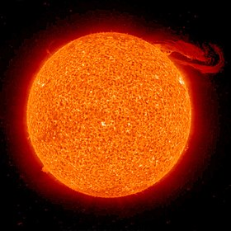

Radiations in space
Space radiation is made up of three kinds of radiation:
  particles shot into space during solar flares,
  galactic cosmic rays and
  particles trapped in the Earth’s magnetic field.
They are composed of electrons, protons, neutrons, heavy ions and gamma rays
Extra galactic
Van Allen belts
Sun
(pictures source: NASA)

Slide 8
Characterization of radiations on devices
Ionization Dose
  Instantaneous dose rate : expressed in rad per unit of time
  Total Ionisation Dose : integration of the instantaneous dose rate over mission life
Non Ionization Dose
  Instantaneous : expressed as Displacement Damage Equivalent Fluence (DDEF) in n/cm²/s
  Total Non Ionisation Dose : integration of the DDEF over mission life expressed in n/cm²
Single Event Effects
  Are not considered here as not applicable to quartz resonators

Slide 9


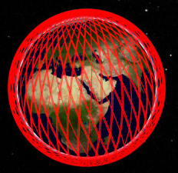
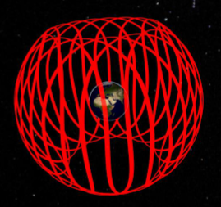
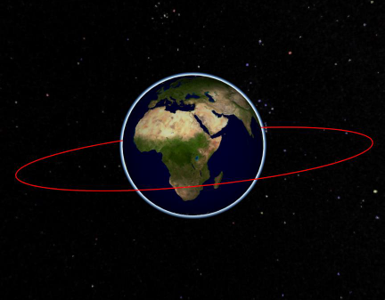
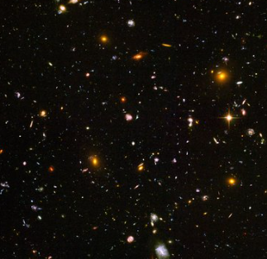
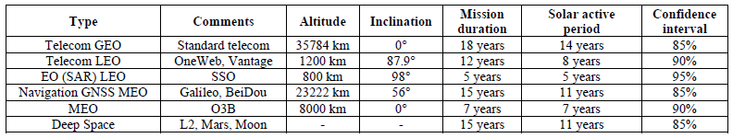
Mission profiles considered
As the radiation depends of the position in space, it depends then on the mission profile.
For the study, 6 profiles were considered:
Telecom GEO
Telecom LEO
LEO SSO
GNSS MEO
MEO O3B
Deep Space

Slide 10
Low dose, TID and TNID evaluation
Radiation profiles were determined by TRAD over the life of each mission using OMERE software developed with support from CNES
Dose rate during the mission
Mission profiles
OMERE software
TID
TNID

Slide 11
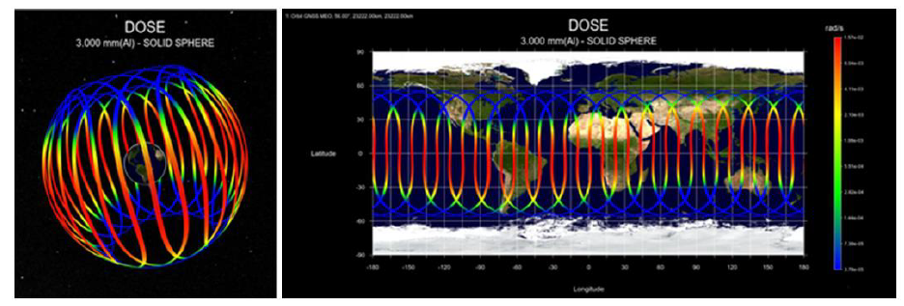
Dose rate mapping
Example of the GNSS MEO mission*:
Dose rate mapping for GNSS MEO orbit. 3D view (left) ; Planisphere view (right)
(*3mm aluminum shielding was considered)

Slide 12
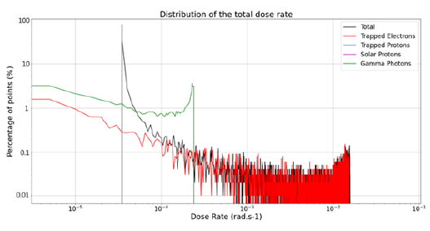
Dose rate statistics over the mission life
Example of the GNSS MEO mission*:
Histogram of the dose rate data for GNSS MEO mission.
(*3mm aluminum shielding was considered)

Slide 13
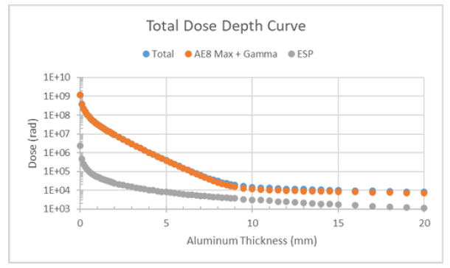
Total Ionization Dose
Total Ionization Dose was calculated, below represented as a function of shielding:
Total dose depth curve for the Navigation GNSS MEO (Galileo, Beidou) orbit

Slide 14
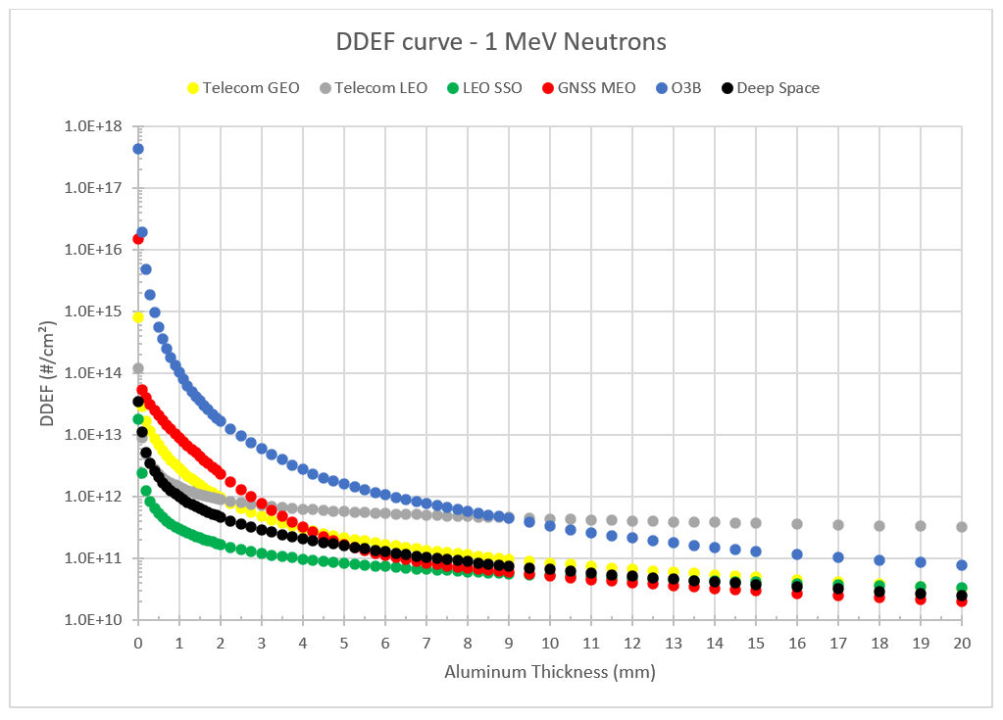
Total Non Ionization Dose
Total Non Ionization Dose could also be calculated represented below as function of shielding
Displacement Damage Equivalent Fluence in 1 MeV Neutrons as a function of Al shielding for the different missions studied

Slide 15
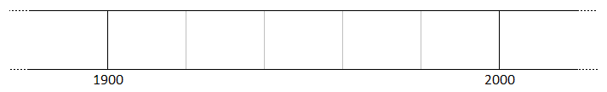
Litterature review
Deep litterature review was performed on the subject of radiations and quartz (240+ articles)
Increased interest for radiation sensitivity because of Nuclear Weapons and Space
1880: Discovery of piezoelectricity (P&J Curie)
1976: Industrial sweeping of quartz bar
Shortage on natural quartz essentially from brazil
Sweeping
studies
Low dose effects studies
WW I
WW II
1956: Commercial process quartz bar growth (Sawyer)
1845: hydrothermal growth of crystal
1898: Discoloration of quartz submitted to cathodic ray (Villard)
1921: Invention of quartz oscillator (Cady)
RAKON studies, articles and production of Ultra Stable Oscillators for space applications.
Work with CNES & SICN/GEMMA
1945:
Radiation effect on quartz resonator frequency (Frondel)
1979:
RAKON ESCC3501 certification
Synthetic timeline around quartz resonators radiation sensitivity

Slide 16
Frequency sensitivity – primary root causes
Main physical phenomena affecting the frequency are the following:
Mass loading: additional weight on the quartz lens will decrease the frequency. This phenomenon can occur through oxidization of the electrode for instance. The order of magnitude of this phenomenon is 1ppm frequency drift per atomic layer. Resonators are especially sealed under secondary vacuum level to avoid further evolution.
Mechanical stress: the stress will affect the frequency through the change of the effective elastic constant driving the mechanical wave. Temperature gradient, barometry or acceleration for instance may change the stress of the vibrating part. For acceleration sensitivity the order of magnitude is 1ppb per g.
Quartz material variations: as the velocity of the wave depends on the material constants change in material will affect the frequency. Material used are synthetic materials that present very low level of defects and very low impurities (typically <1ppm)

Slide 17
Bibliography review outcome w.r.t. radiations sensitivity
Radiation sensitivity characteristic
  Low dose rate can generate quite strong frequency drift that return back after radiation is off
  TID tends to stabilize the frequency and the dependency to radiation
  TNID not considered as its impact is low on the frequency
Rootcauses
  Quartz material quality clearly a key point in radiation sensitivity.
  Low Dose Rate Sensitivity however not well understood.
  Possibly due to mechanical stressed induced by charge accumulations in surface, subsurface and electrode defects.

Slide 18
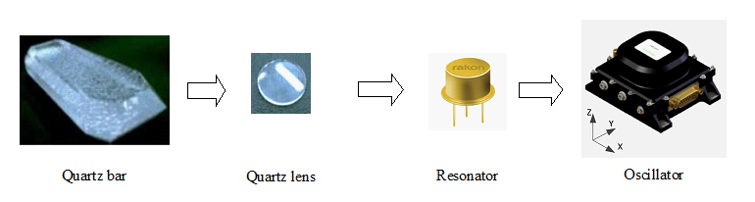
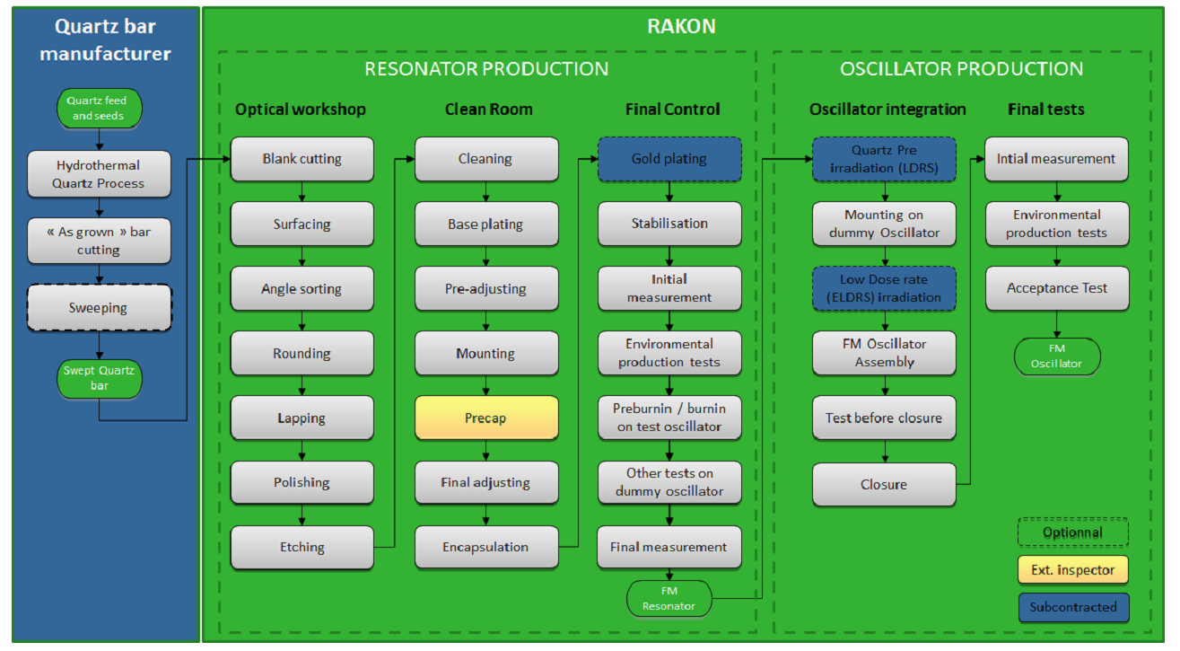
From quartz bar to oscillator

Slide 19
Test vehicles of the Design Of Experiment
Considering the New Space market and the technical aspects, RAKON chose to study:
3 enclosures : T807, T1507 and SMD
2 quartz cuts: AT-cut and SC-cut
3 frequencies: 10, 50 and 100MHz
4 different materials: THQ, HQ SW, HQ, SQ. The THQ material is the Cristal Innov material considered as a reference material for the study. HQ and HQ SW are respectively High Quality and High Quality Swept material, SQ is Standard Quality material.
3 electrodes materials: aluminum, silver, gold
2 kinds of sub-surfaces preparation
2 kinds of cleaning
Given the number of possible combinations, the most meaningful combinations were chosen leading to:
6 variants for T1507 10MHz SC-cut resonators
8 variants for T807 100MHz AT- and SC-cut resonators
1 variant for SMD 50MHz AT-cut resonators

Slide 20
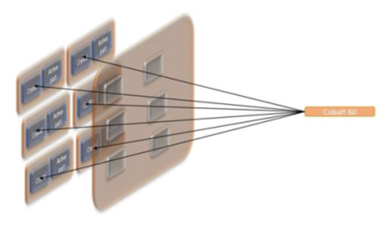
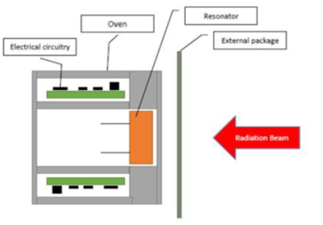
Principle for Low Dose Rate sensitivity measurement
Given the precision required the resonators must be measured in oscillators
However, oscillator parts must be protected from radiation to avoid induced effect in electronic
As the gamma radiation source cannot be turned ON/OFF a movable shield is used
Moveable screen
Fixed screen
Beam
Gamma ray source
Oscillator structured so as to expose ony the resonator in the beam
Fixed screen used to hide electronic parts from the beam and movable screen to perform the LDR cycling

Slide 21
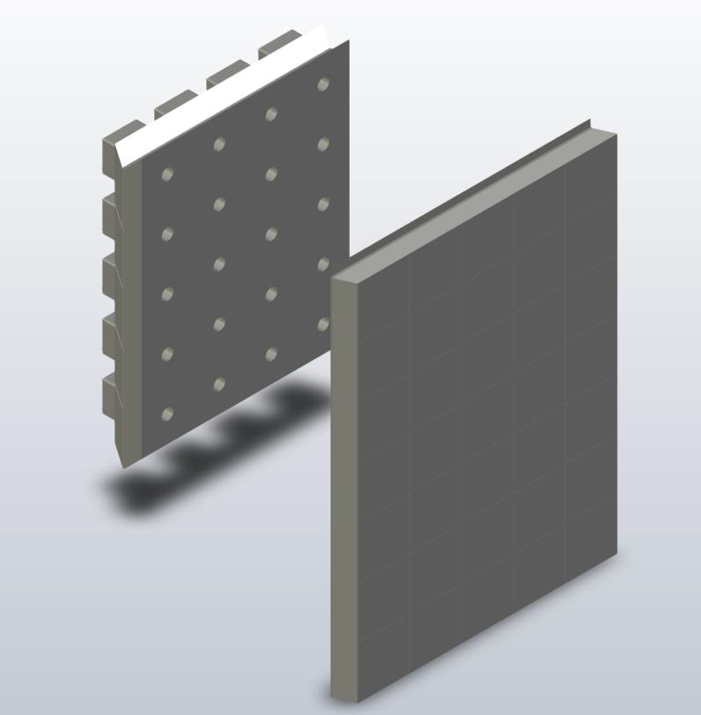
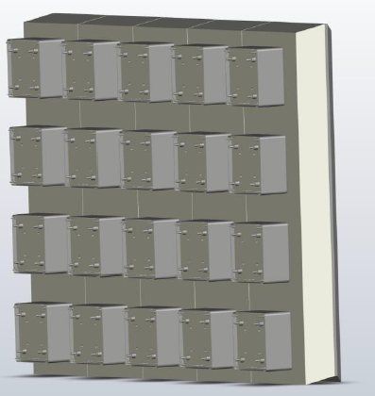
Design of the parts
Lead wall (fixed and moveable) were designed
Oscillators were designed and adapted for each enclosures and frequencies
Lead walls
Test oscillators

Slide 22
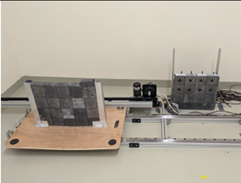
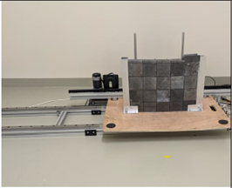
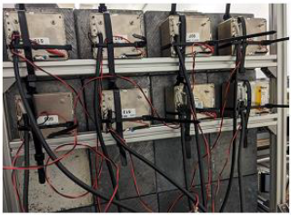
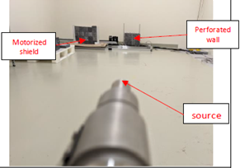
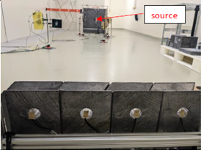
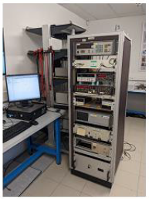

Low dose test system
Motorized shield open
Motorized shield closed
Oscillators plugued behind the lead wall
Image of the lead wall from the source
Image of the source from the lead wall
Measurement system out of the bunker

Slide 23
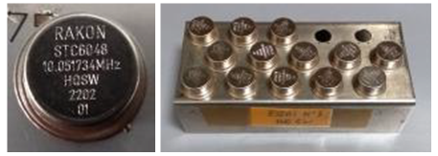
Production of resonators & oscillators
Resonators were produced as per specification on the ESCC3501 qualified line
In total, 200+ resonators were produced over the 15 groups with all corresponding datapackages
In each group, 4 pieces were selected as considered to be representative
i.e. 60 resonators in total available for the next steps
60 oscillators manufactured from which 24 are up and ready
Image of resonators from one of the 15 groups

Slide 24
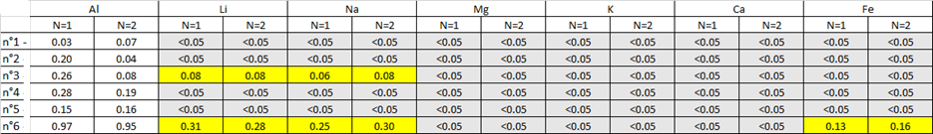
Results of impurities analysis
All materials are presenting quite low level of impurities (<1ppm)
Cristal Innov material being the purest one
Impurities ions in the different materials (in ug/g)

Slide 25
Test plan
To adress the expressed problematic following test plan will be applied :
Continuous measurement
Continuous measurement
Continuous measurement
Low dose rate Cycling
Few rad/h
Exposure 20min
Non exposure 100 min
8 cycles - 16 hours
High dose deposition
on resonator
180rad/h
7 days 30kRad
Low dose rate Cycling
Few rad/h
Exposure 20min
Non exposure 100 min
8 cycles - 16 hours
High dose deposition
on resonator
180rad/h
7 days 30kRad
Low dose rate Cycling
Few rad/h
Exposure 20min
Non exposure 100 min
8 cycles - 16 hours
Device characterization
Device characterization
Device characterization
Device characterization
Device characterization
Device characterization

Slide 26
Conclusion & perspectives
In this presentation we exposed the objective of the MINCOR project, and the work done up-to-now:
resonator and oscillator types relevant for the study were determined based on market study,
mission profiles and their corresponding radiation level over mission life were determined,
following a literature review, material and process variants to be studied were determined,
different quartz materials were analyzed confirming the state-of-the-art level of Cristal Innov material,
resonators needed for the irradiation study were produced, screened and tested,
a suited method for assessing resonator performance without perturbation by the oscillator was developed and
a test plan was defined
Next steps are ongoing with the measurement of the Low Dose rate behavior of the 60 resonators. First results are expected in last quarter of 2024.

Slide 27
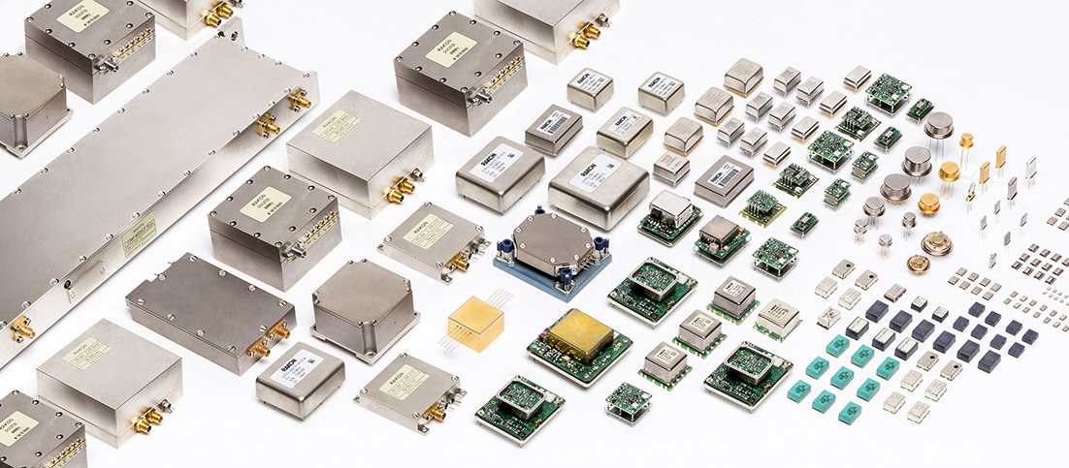
Thank you !
www.rakon.com
Equipment • Subsystems • Oscillators • Filters • Resonators

